Slide 1

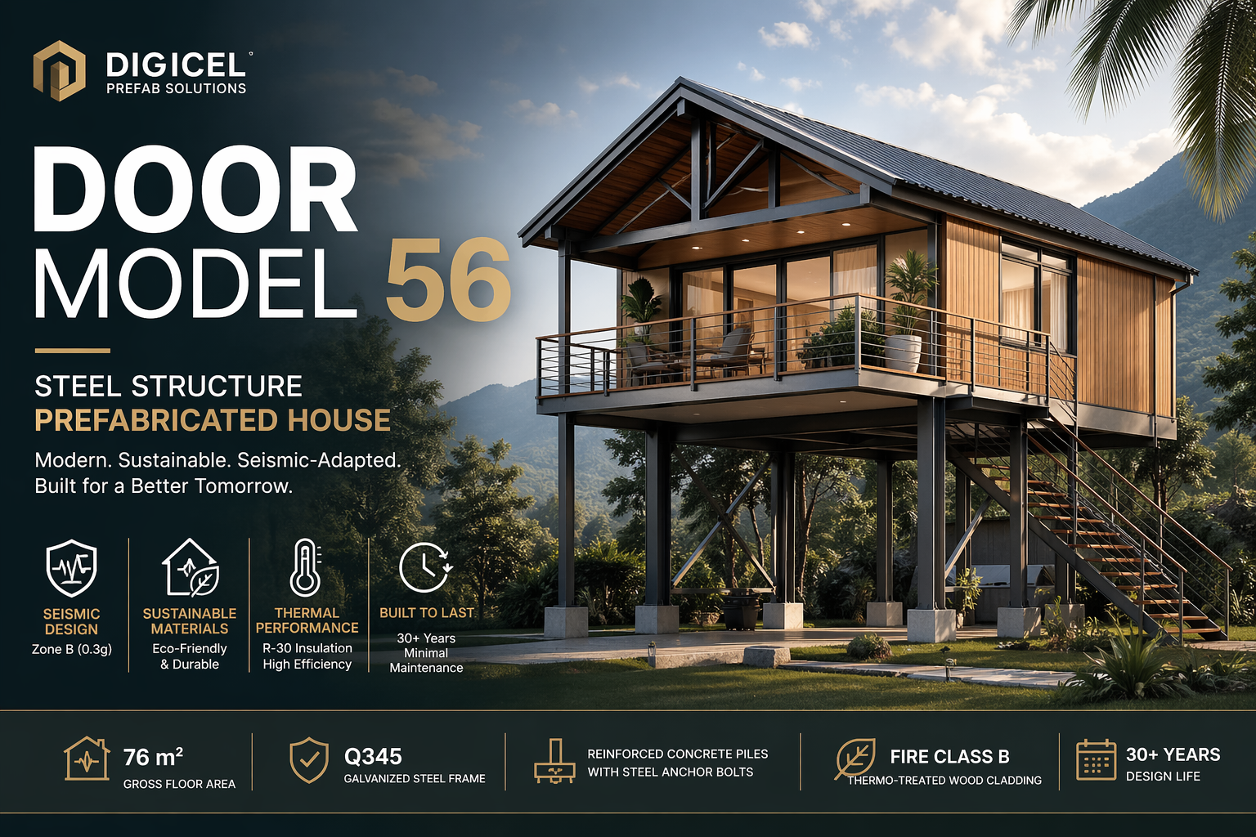

Slide 2
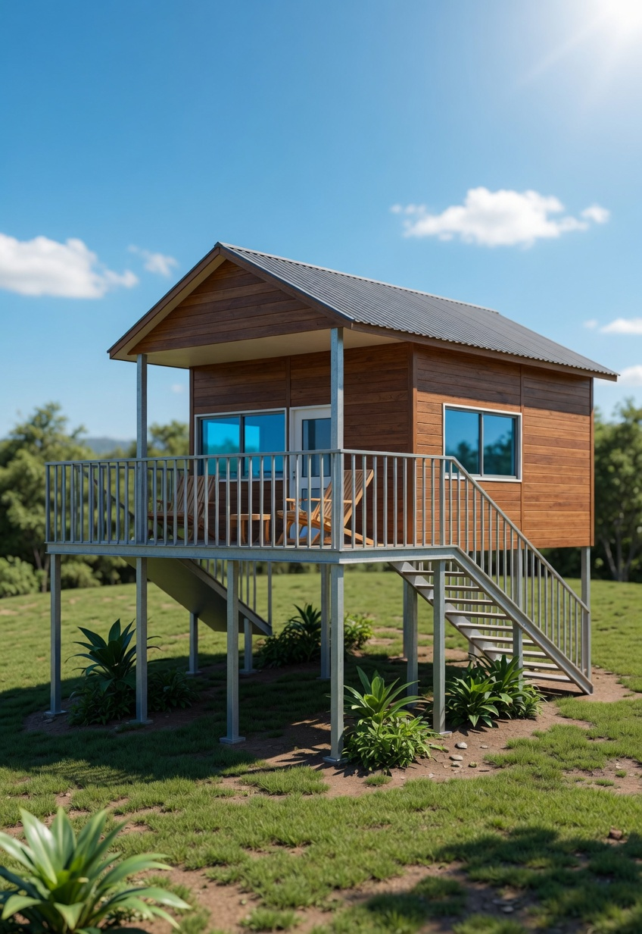
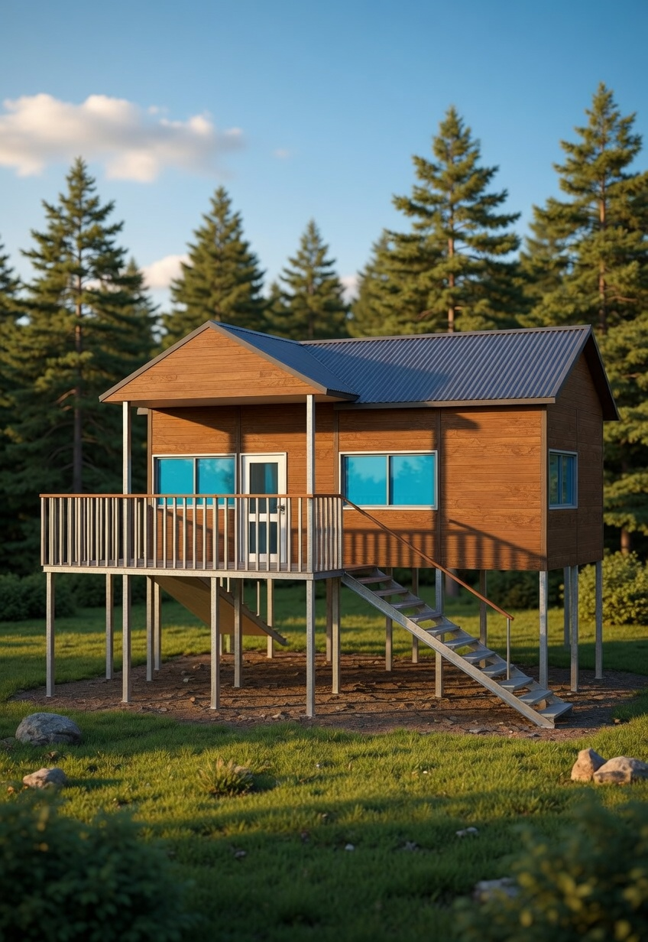
Door Model 56
Steel Structure Prefabricated House

Slide 3
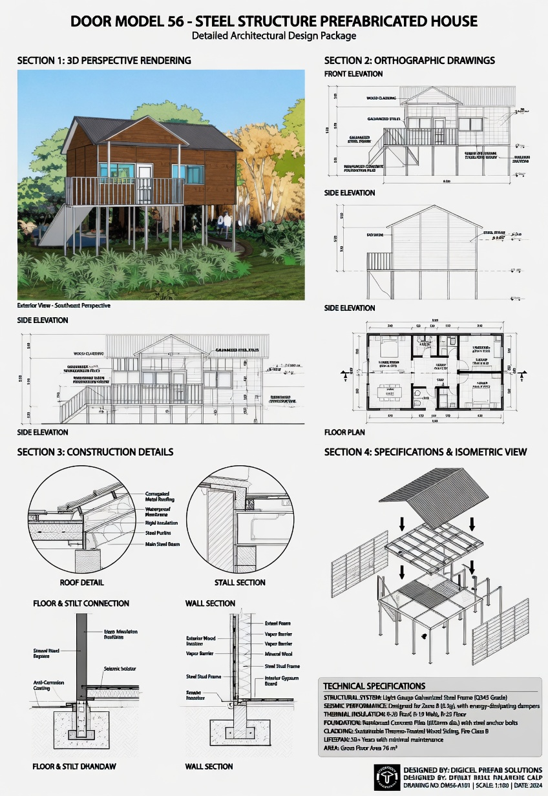

Slide 4
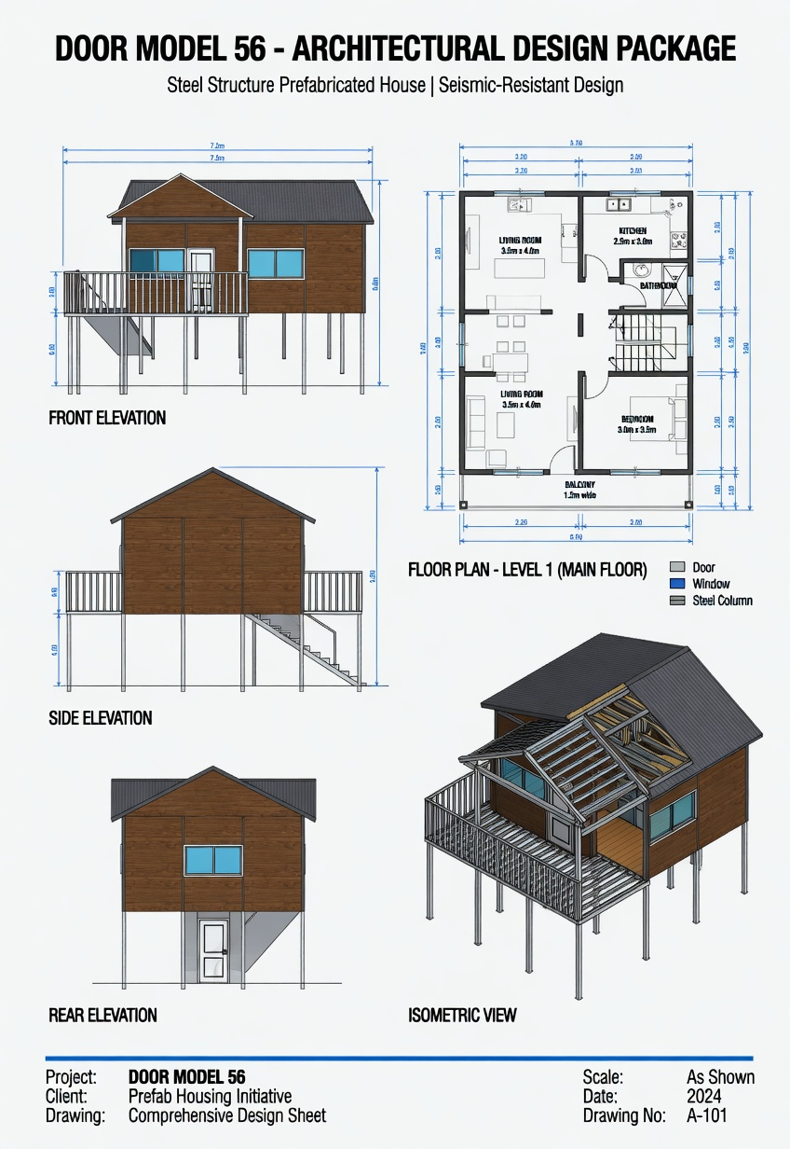

Slide 5
General Description
Two-story elevated prefabricated house
Modern tropical/seismic design
76 m² floor area
30+ years lifespan
Residential use

Slide 6
Structural System
Light-gauge galvanized steel (Q345)
Seismic Zone B (0.3g)
Reinforced concrete piles
Steel stilts & isolators

Slide 7
Exterior & Cladding
Thermo-treated wood siding
Fire Class B
Galvanized steel supports
Corrugated metal roofing

Slide 8
Interior Construction
Wood cladding exterior
Vapor barrier
Mineral wool insulation
Steel frame + gypsum board

Slide 9
Thermal & Energy
R-30 insulation (roof/floor)
Energy-efficient design
High-performance wall insulation

Slide 10
Floor Plan
Living & dining area
Kitchen
2 Bedrooms
Bathroom
Storage + Balcony

Slide 11
Construction Details
Layered roof system
Seismic floor connections
Weatherproof wall assembly

Slide 12
Technical Summary
Q345 Steel Frame
76 m² area
30+ years life
Concrete pile foundation
Fire-resistant cladding

Slide 13
Key Features
Elevated for flood protection
Eco-friendly materials
Fast modular construction

