Slide 1
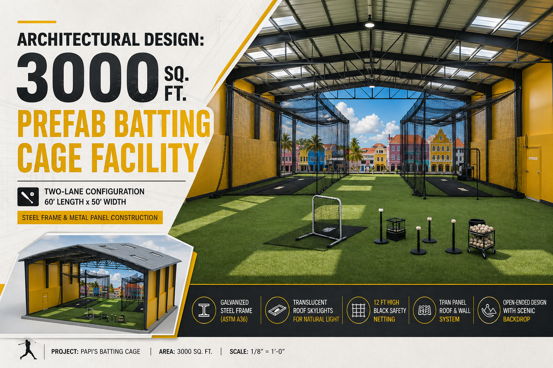

Slide 2
Island Swing Batting Cage Facility
3000 Sq. Ft. Pre-Fabricated Two-Lane Sports Facility.

Slide 3
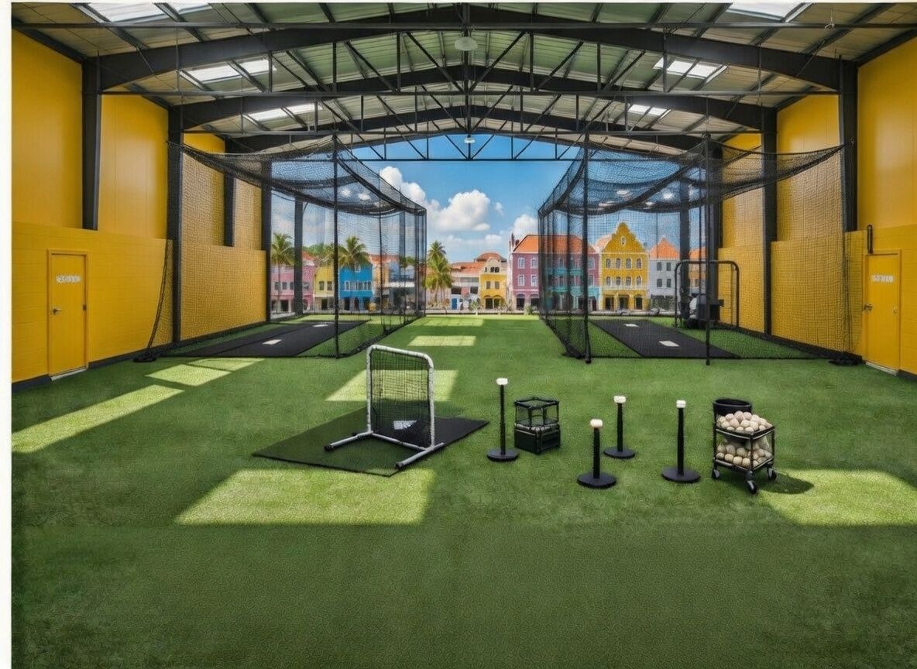

Slide 4
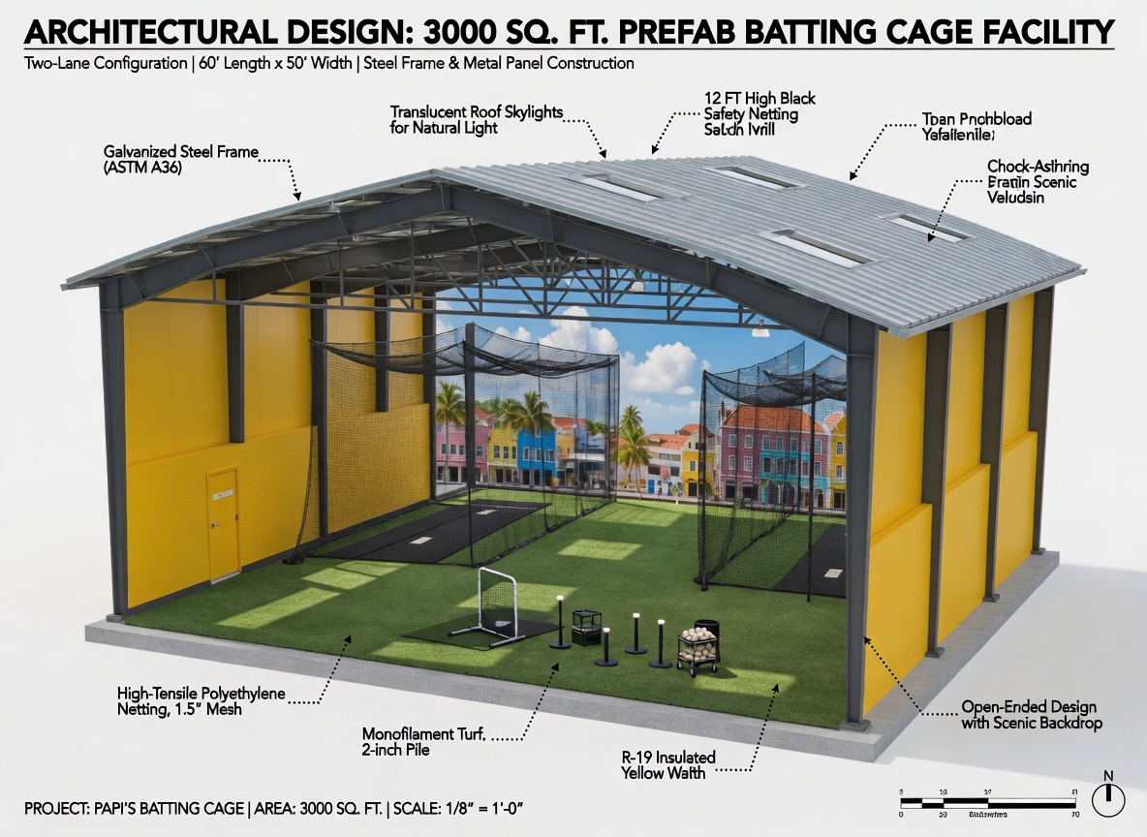

Slide 5
Project Overview
Prefabricated Sports Facility
Baseball / Softball Batting Practice
Total Area: 3000 Sq. Ft.
Two-Lane Configuration
Steel Frame Structure

Slide 6
Key Dimensions
Length: 60 ft
Width: 50 ft
Height: Approx. 20–24 ft
Dual batting lanes with divider netting

Slide 7
Architectural Design Concept
Modern industrial sports facility
Open-ended ventilation design
Bright yellow wall panels
Arched roof system
Outdoor scenic integration

Slide 8
Interior Features
Monofilament turf (2-inch pile)
Dual batting cages
Divider netting
Training equipment space
Natural daylight via skylights

Slide 9
Structural System
Galvanized Steel Frame (ASTM A36)
Steel trusses @ 10 ft O.C.
Wide-span design
Reinforced concrete slab foundation

Slide 10
Roofing System
Corrugated metal roof
Integrated skylights
Weather protection
Heat reduction

Slide 11
Wall & Insulation
Metal panel walls
R-19 insulation
Low maintenance
Weather resistant

Slide 12
Safety Features
High-tensile netting
12 ft safety walls
Divider net system
Player protection

Slide 13
Floor Plan Layout
Two batting lanes
Central divider
Equipment zones
Clear player circulation

Slide 14
Construction Specifications
Prefabricated components
Bolt-together system
Fast installation
Cost-efficient design

Slide 15
Lighting & Electrical
LED high-bay lights
500 lux illumination
GFCI outlets
Optional smart controls

Slide 16
Advantages
Fast construction
Low maintenance
Durable structure
Expandable design

Slide 17
Applications
Sports academies
Schools & colleges
Training centers
Commercial use

