Slide 1
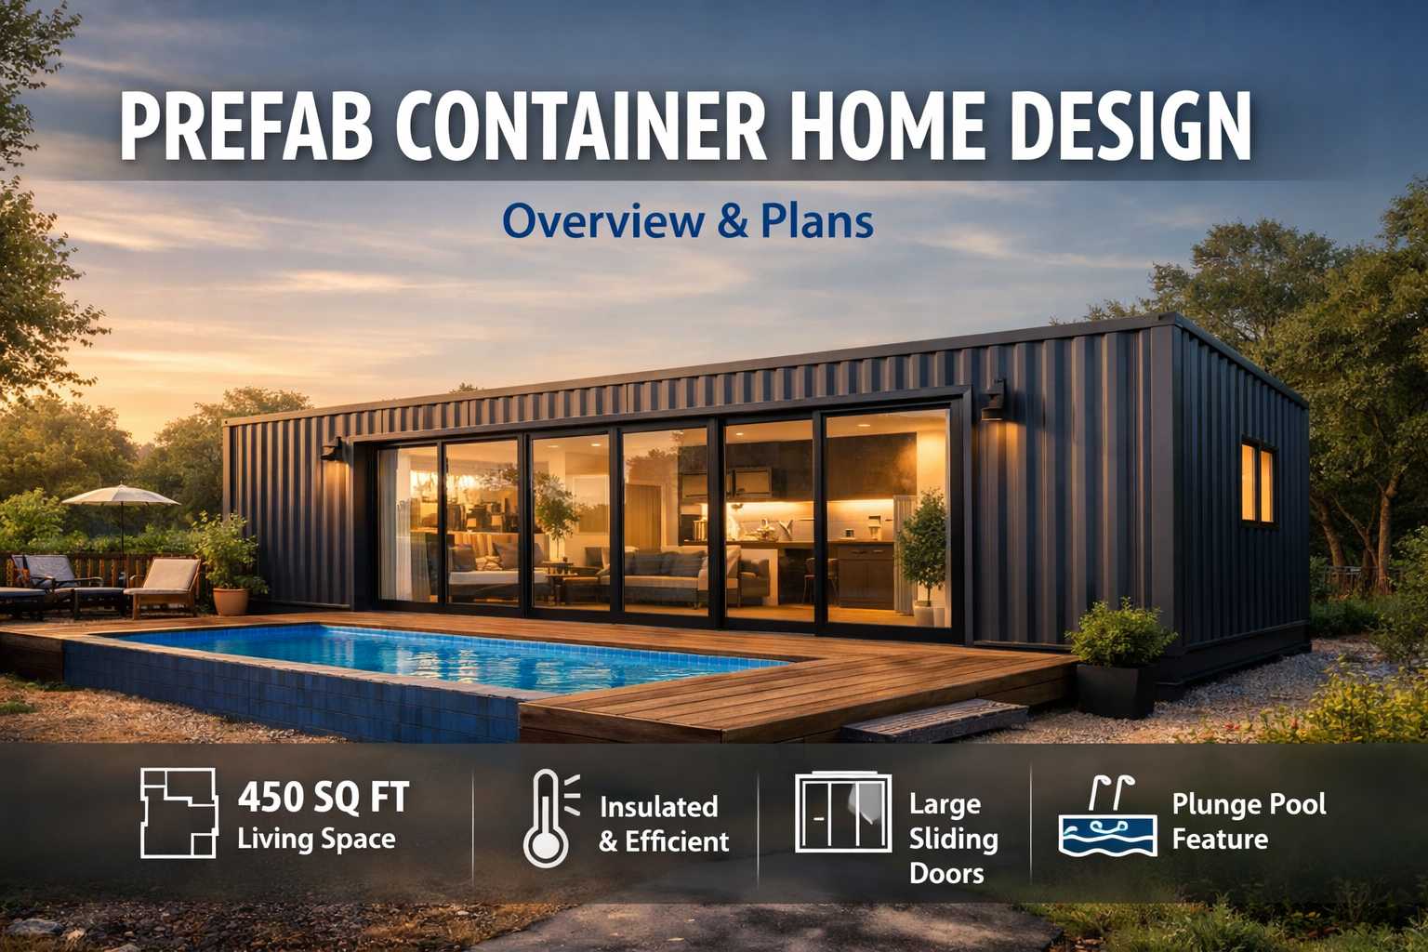


Slide 2
Prefabricated Container Home
450 sq ft Modern Compact Living Solution

Slide 3
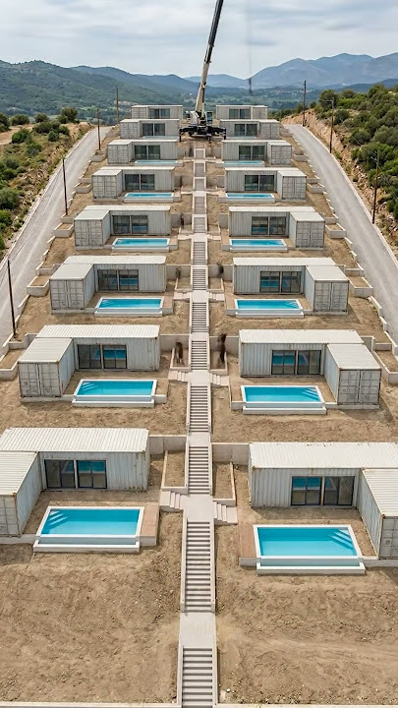
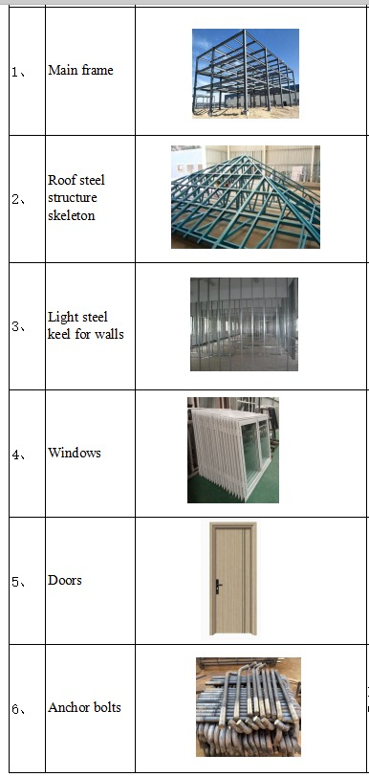

Slide 4
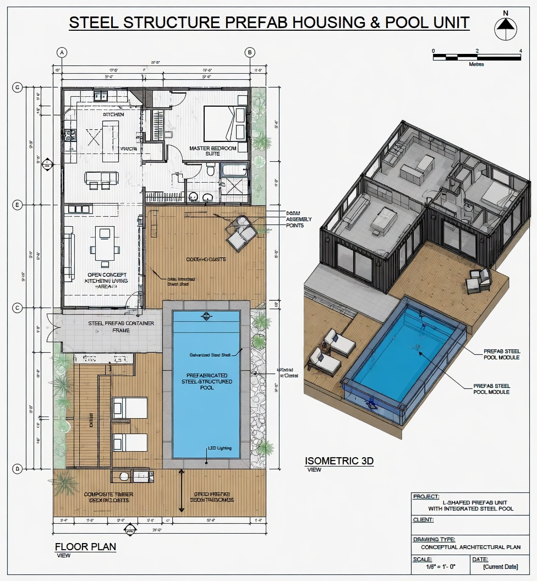

Slide 5
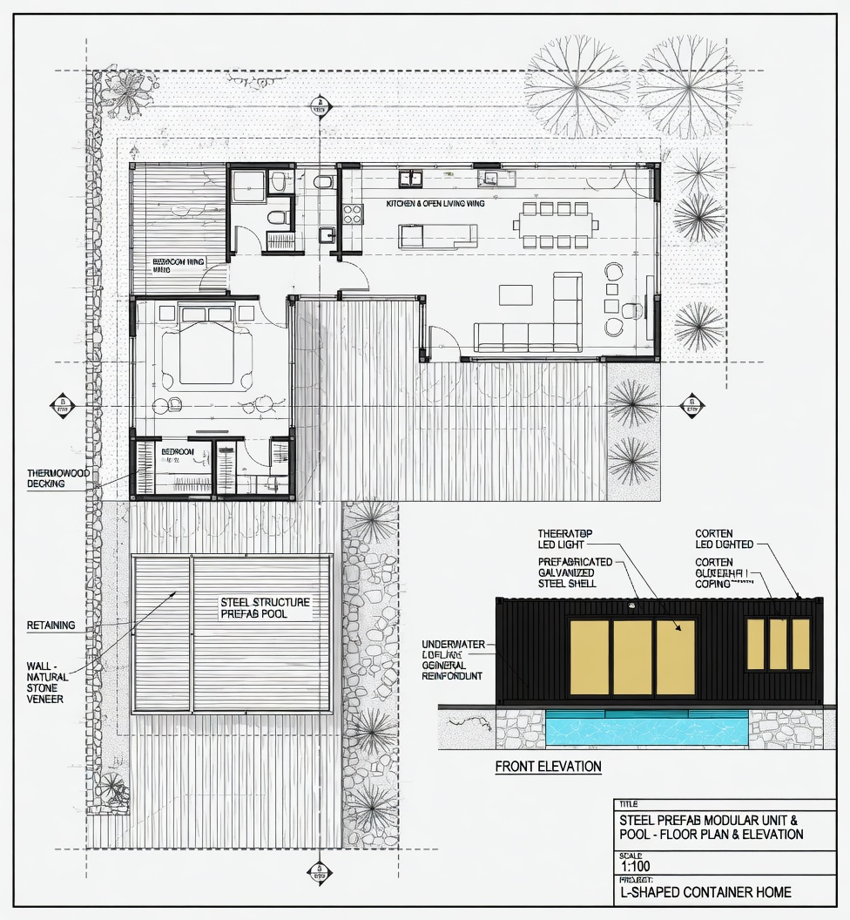

Slide 6
Introduction
Compact prefabricated container home
Approx. 12.2m (40 ft) × 2.4m (8 ft)
Total area: ~450 sq ft
Designed for modern, efficient living

Slide 7
Design Philosophy
Maximizes space efficiency
Emphasis on natural light
Indoor-outdoor connectivity
Modern industrial aesthetic

Slide 8
Structural Overview
Steel container-based framework
Corrugated steel exterior
High-performance insulation system
Durable and weather-resistant construction

Slide 9
Key Structural Features
Raised foundation platform
Waterproofed roof system
Steel framing for strength
Integrated utility connections

Slide 10
Exterior Features
Corrugated galvanized steel cladding
Minimalist modern appearance
Vertical line design emphasis
Durable exterior finish

Slide 11
Windows & Doors
Large triple-panel sliding glass doors
Standard side entry door
Operable windows for ventilation
Enhanced natural lighting

Slide 12
Front Elevation
Full-length sliding glass facade
Strong indoor-outdoor connection
Integrated plunge pool feature
Clean, modern visual identity

Slide 13
Side Elevation
Compact 2.4m width profile
Entry door with adjacent window
Efficient vertical design
Structural steel visibility

Slide 14
Floor Plan Overview
Open-concept layout
Optimized for 450 sq ft
Smooth circulation between spaces
Balanced zoning

Slide 15
Living Area
Central open space
Direct access to sliding doors
Bright and airy atmosphere
Multi-functional usage

Slide 16
Bedroom
Private sleeping area
Space for standard bed
Minimal furnishings
Comfortable layout

Slide 17
Kitchenette
Compact and efficient design
Includes refrigerator, cooktop, sink, storage

Slide 18
Bathroom
Enclosed private space
Sliding door for space-saving
Includes toilet, sink, shower

Slide 19
Plunge Pool Feature
External but integrated design
Accessible from living area
Enhances luxury and comfort
Ideal for warm climates

Slide 20
Section View Insights
Layered wall construction
Insulated floor system
Waterproofed roof assembly
Structural integrity details

Slide 21
Construction Details
Steel cladding + insulation layers
Vapor barriers for protection
Raised flooring system
Drainage and waterproofing

Slide 22
Energy Efficiency
High-performance insulation
Reduced heating/cooling needs
Efficient glazing system
Sustainable material use

Slide 23
Sustainability
Reuse of container structure
Reduced construction waste
Eco-friendly design approach
Lower environmental impact

Slide 24
Customization Options
Modular expansion capability
Multiple unit combinations
Flexible interior layouts
Adaptable to different needs

Slide 25
Installation & Deployment
Prefabricated off-site
Quick on-site installation
Minimal disruption
Suitable for various terrains

Slide 26
Conclusion
Smart compact living solution
Durable and modern design
Efficient space utilization
Ideal for residential or vacation use

