Slide 1
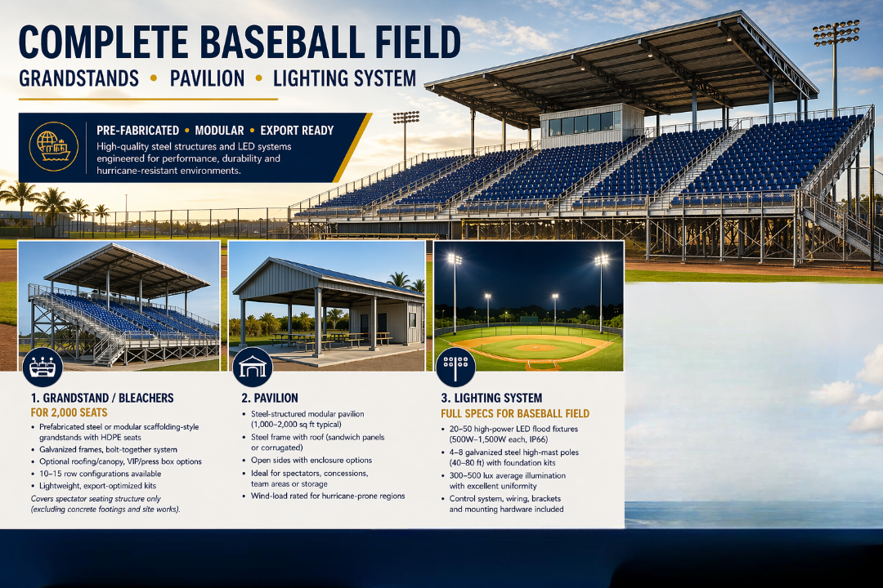

Slide 2
Project Overview
Baseball field for ~2,000 spectators
Scope: Grandstands, Pavilion, LED Lighting
Materials only

Slide 3
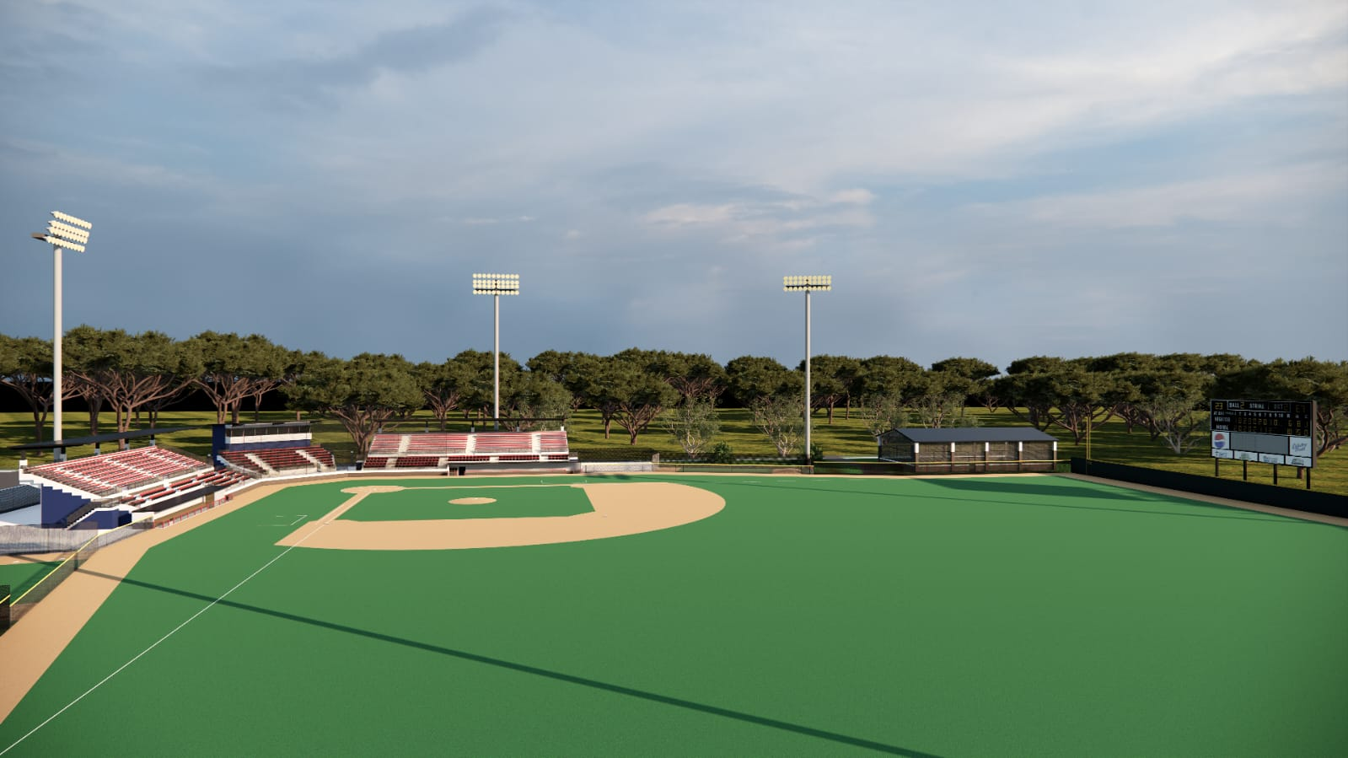

Slide 4
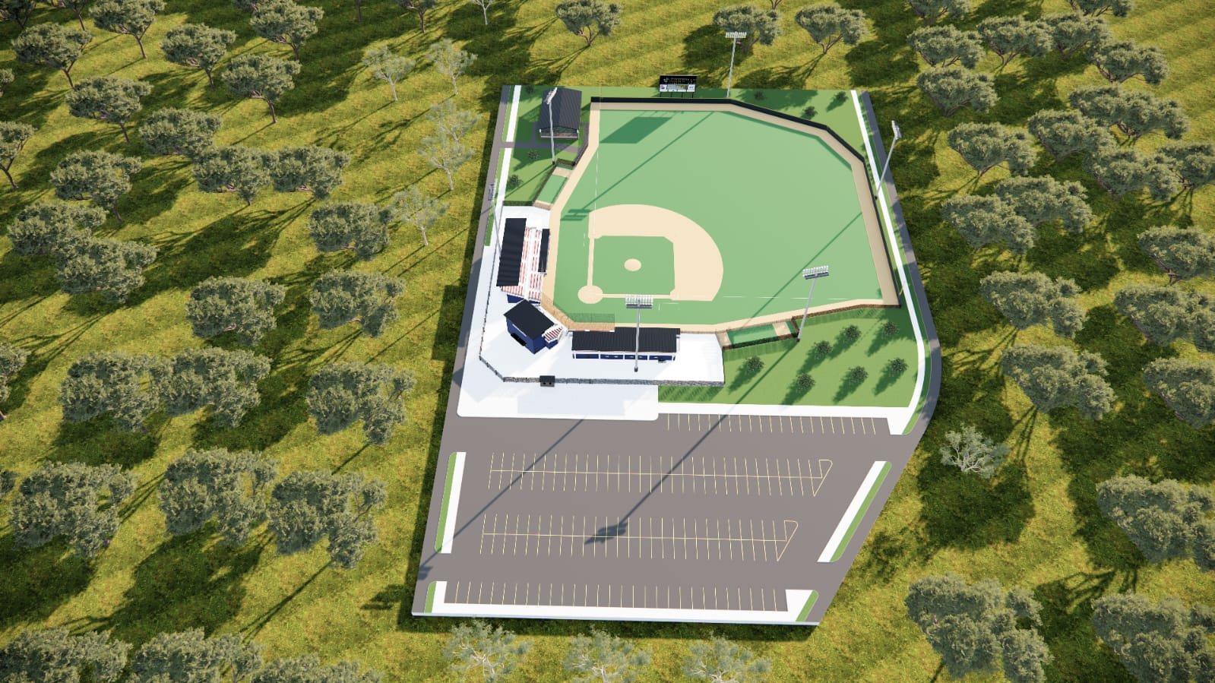

Slide 5
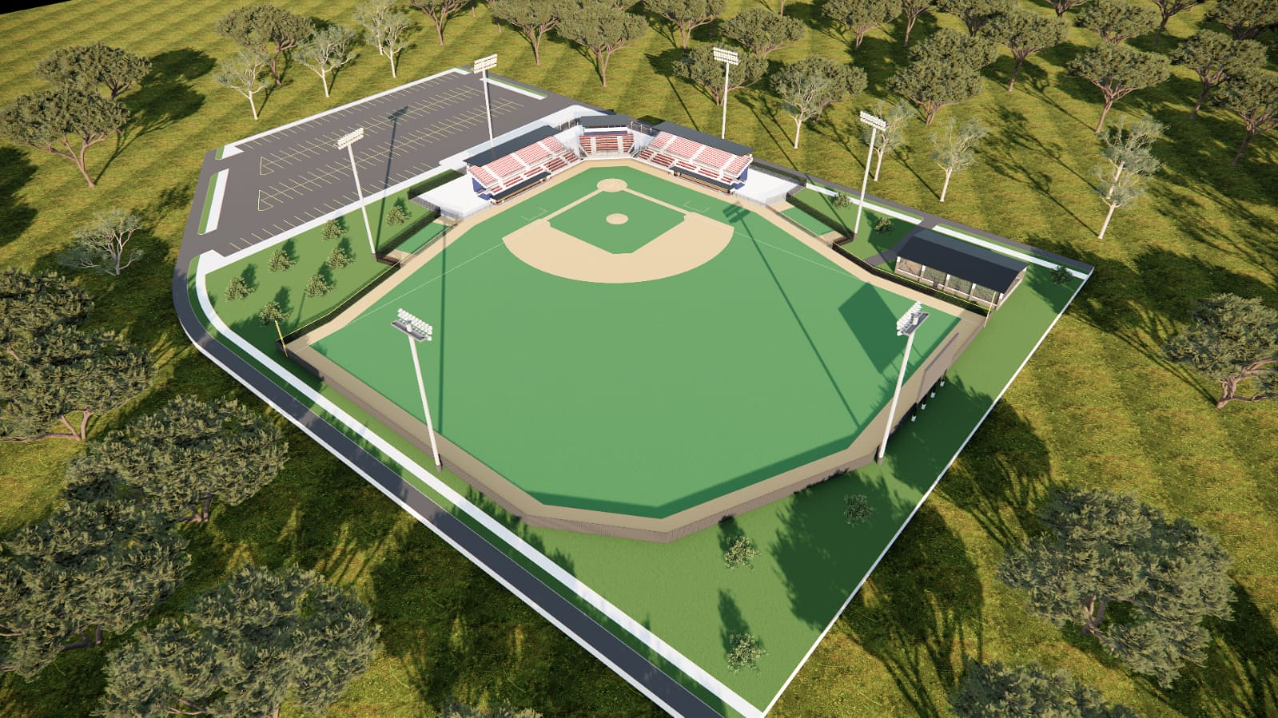

Slide 6
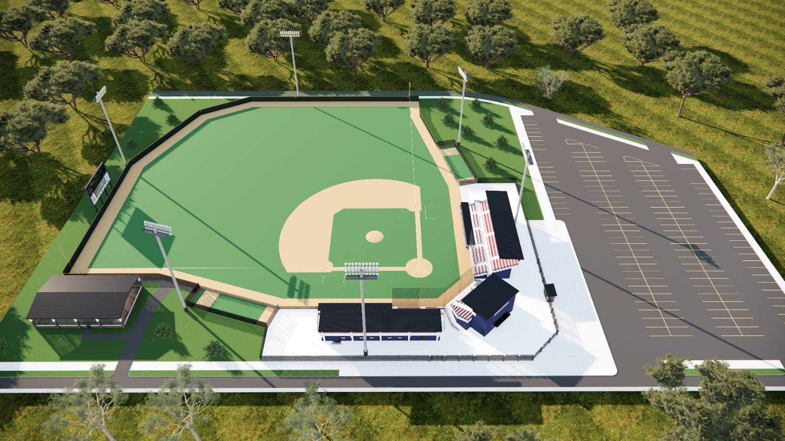

Slide 7
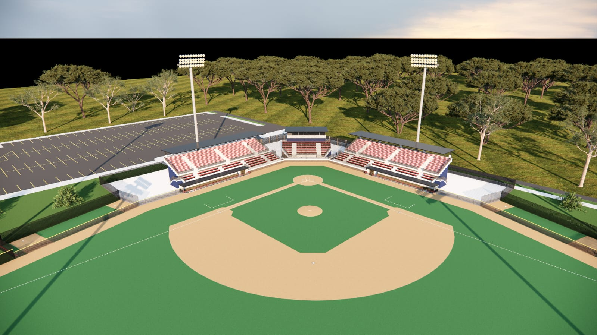

Slide 8
Pavilion
Estimated size: ~1,500 sq ft
Prefab steel structure

Slide 9
Lighting System
20–50 LED fixtures (500W–1500W)
4–8 steel poles
300–500 lux lighting level

Slide 10
Key Considerations
Hurricane-resistant design
Field dimensions and lighting specs
Local compliance in Aruba
Foundation and installation not included

