Slide 1

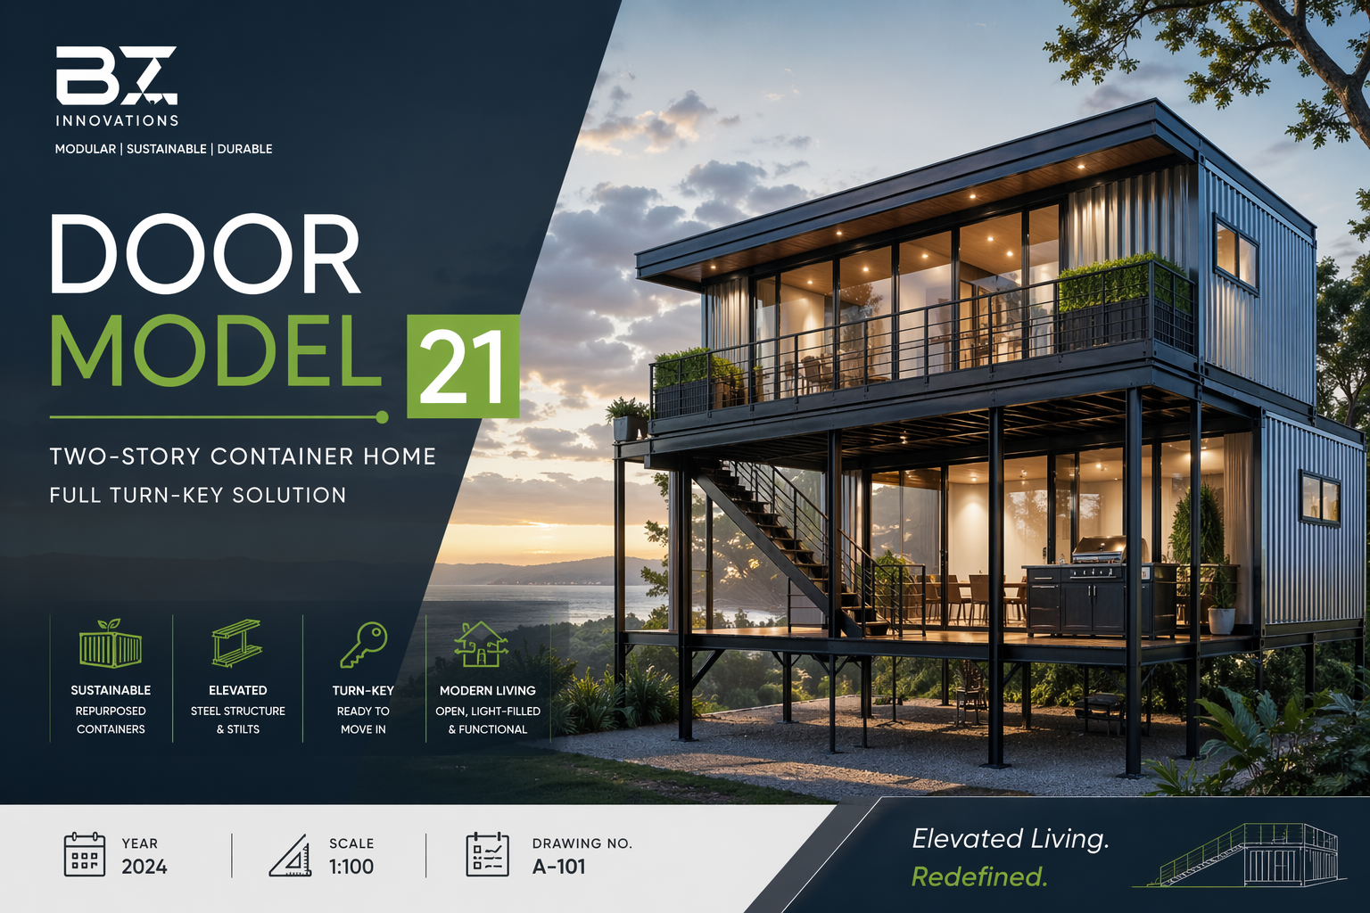

Slide 2
Door Model 21 Container Home
Modern Two-Story Container Home
Designed by BZ Innovations
Turn-Key Prefabricated Solution

Slide 3
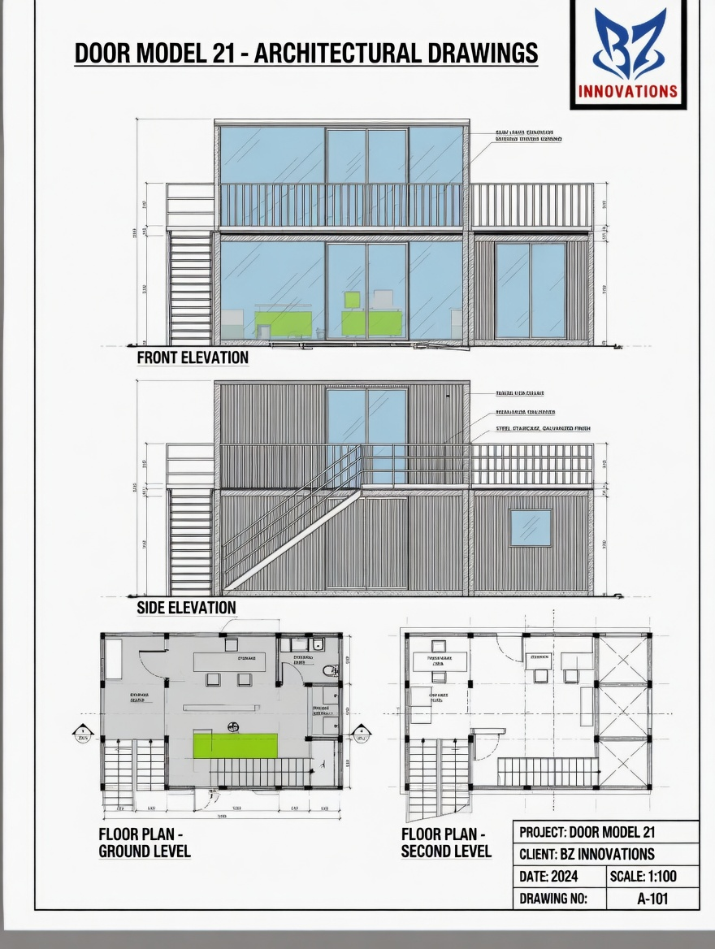

Slide 4
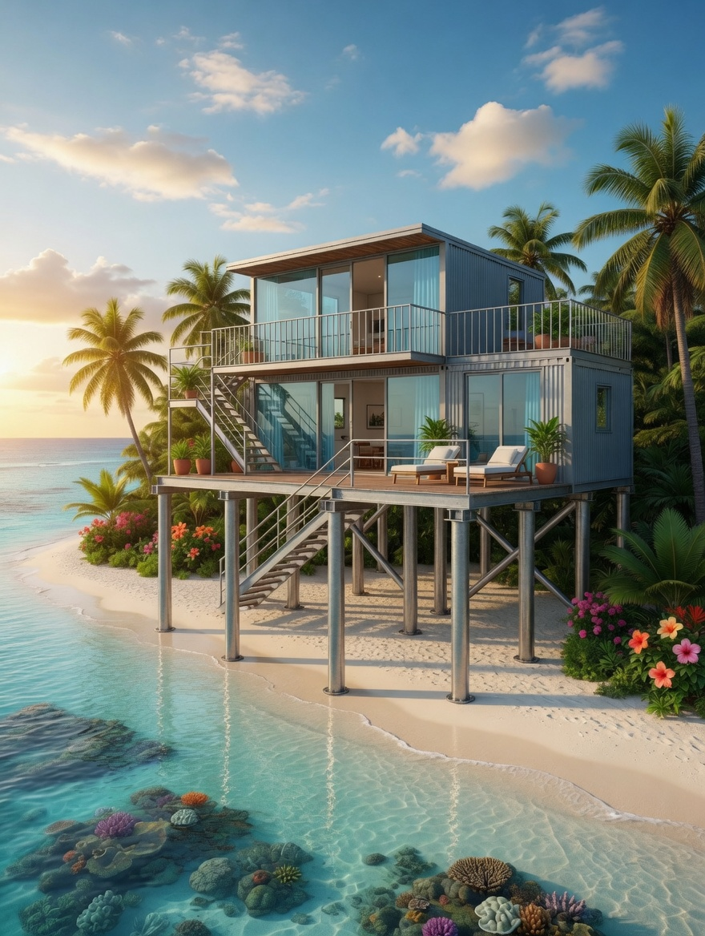

Slide 5
Project Overview
• Two-story elevated container home
• Built from repurposed shipping containers
• Steel structure with stilts
• Modern industrial aesthetic

Slide 6
Design & Structure
• Elevated steel platform
• Improved flood resistance
• Enhanced ventilation
• Space below for storage or outdoor use

Slide 7
Front Elevation Features
• Floor-to-ceiling glass windows
• Sliding doors
• Upper-level balcony
• External staircase
• Green design accents

Slide 8
Side Elevation Features
• Steel stilts support structure
• Corrugated steel cladding
• Diagonal staircase
• Secondary balcony/overhang

Slide 9
Ground Floor Plan
• Open-plan living area
• Entrance porch
• Storage space
• Powder room
• Flexible room (office/bedroom)
• Staircase access

Slide 10
Second Floor Plan
• Primary bedroom with en-suite
• Additional bedroom/multipurpose room
• Living/kitchen/dining area
• Balcony access

Slide 11
Materials & Features
• Galvanized corrugated steel
• Large glass panels
• Metal railings
• Outdoor kitchen provisions
• Energy-efficient design

Slide 12
Turn-Key Solution
• Fully finished interiors
• Plumbing & electrical systems
• Kitchen and appliances
• Climate control systems

Slide 13
Conclusion
• Sustainable and modern design
• Efficient use of space
• Suitable for various terrains
• Stylish elevated living

