Slide 1
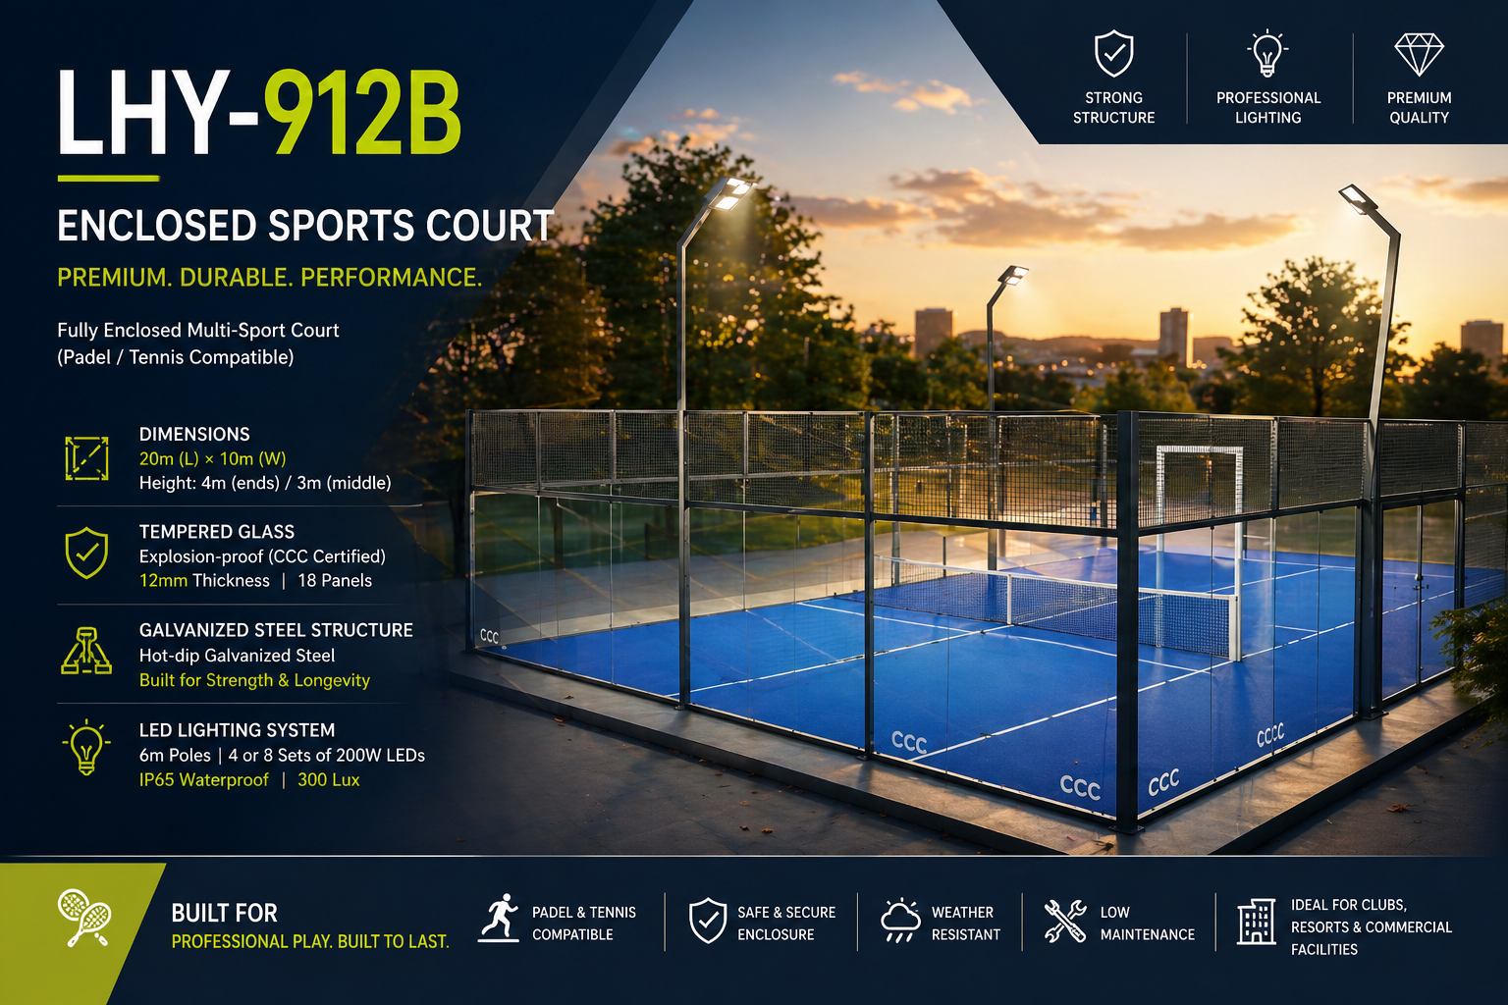

Slide 2
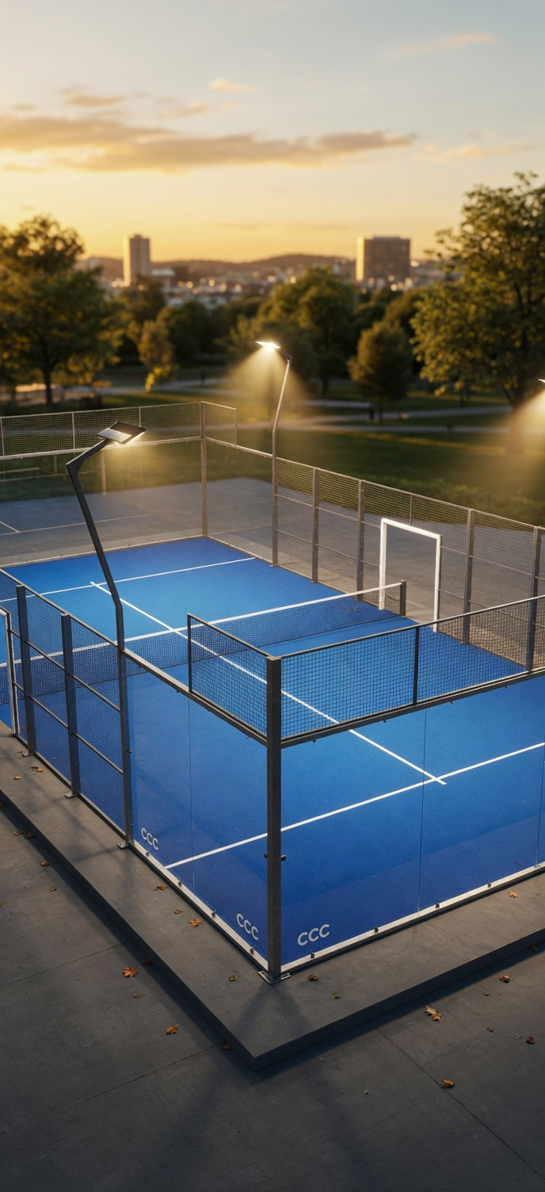
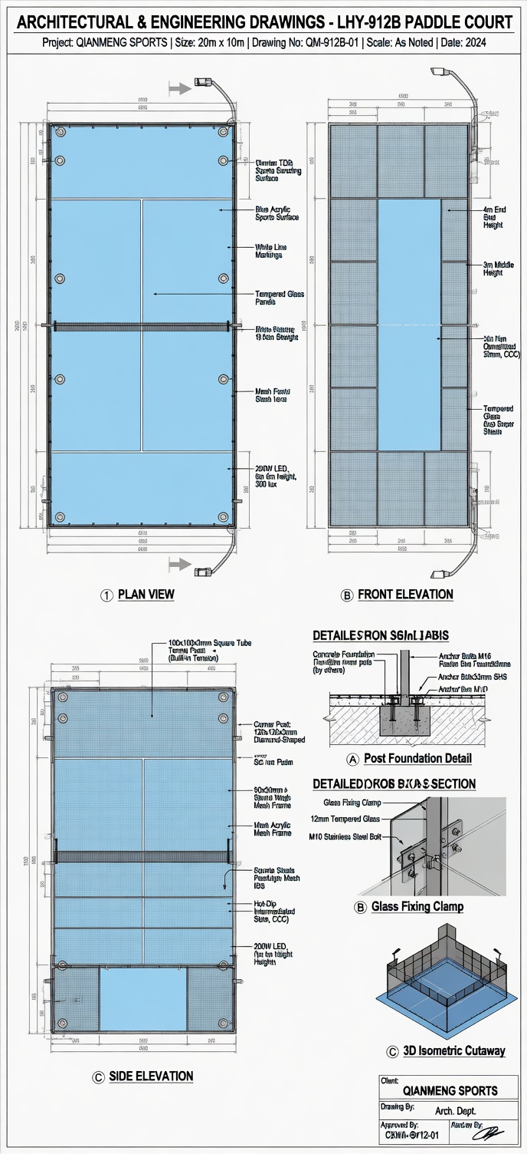

Slide 3
LHY-912B Enclosed Sports Court
Product Overview
Model: LHY-912B
Type: Fully Enclosed Multi-Sport Court (Padel / Tennis)
Key Dimensions:
- Length × Width: 20 m × 10 m
- Height: 4 m (ends) / 3 m (middle)

Slide 4
Structural Specifications
Tempered Glass Enclosure:
- Explosion-proof (CCC)
- Panel Size: 2 m × 3 m × 12 mm
- Total Panels: 18
Post & Fence System:
- Hot-dip galvanized steel
- Corner Posts: 120×120×3 mm
- Main Columns: 100×100×3 mm
- Crossbeams: 50×100×2.5 mm
- Mesh: 50×50 mm grid (4 mm wire)

Slide 5
Lighting System
Professional LED Lighting:
- Poles: 6 m height
- LEDs: 4 or 8 × 200 W
- Protection: IP65
- Illumination: 300 lux (uniform)

Slide 6
Netting & Infrastructure
Tennis Posts:
- 100×100×3 mm steel
- Built-in tensioning system
Additional Features:
- High-visibility netting
- Strong corner anchoring
- High-impact sports ready

Slide 7
Product Description
Premium enclosed multi-sport court for padel & tennis.
20×10 m compact design with sloped roof for safety.
Durable tempered glass + galvanized steel structure.
Professional lighting & robust infrastructure.
Ideal for clubs, hotels, and commercial venues.

