Slide 1
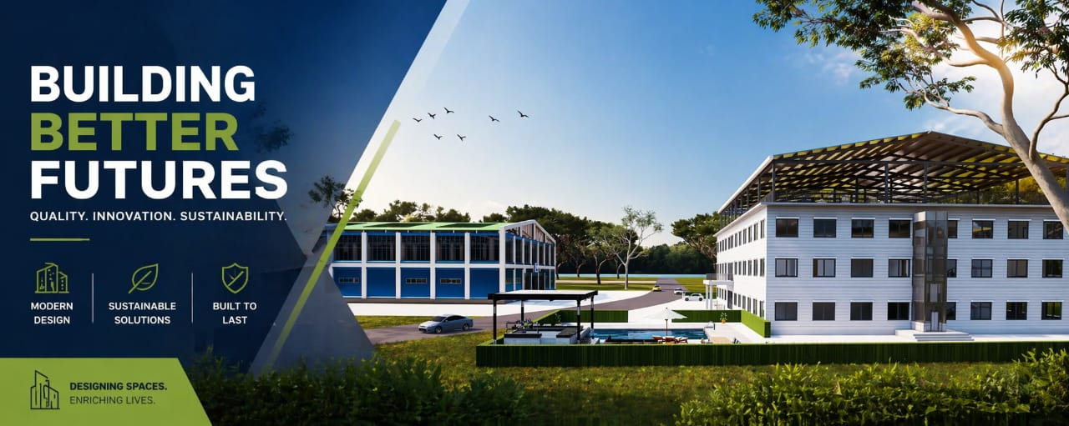

Slide 2
Project Overview
20-room hotel project with lobby, gaming area, and rooftop space.
Estimated total building size: ~15,000 sq ft (midpoint).

Slide 3
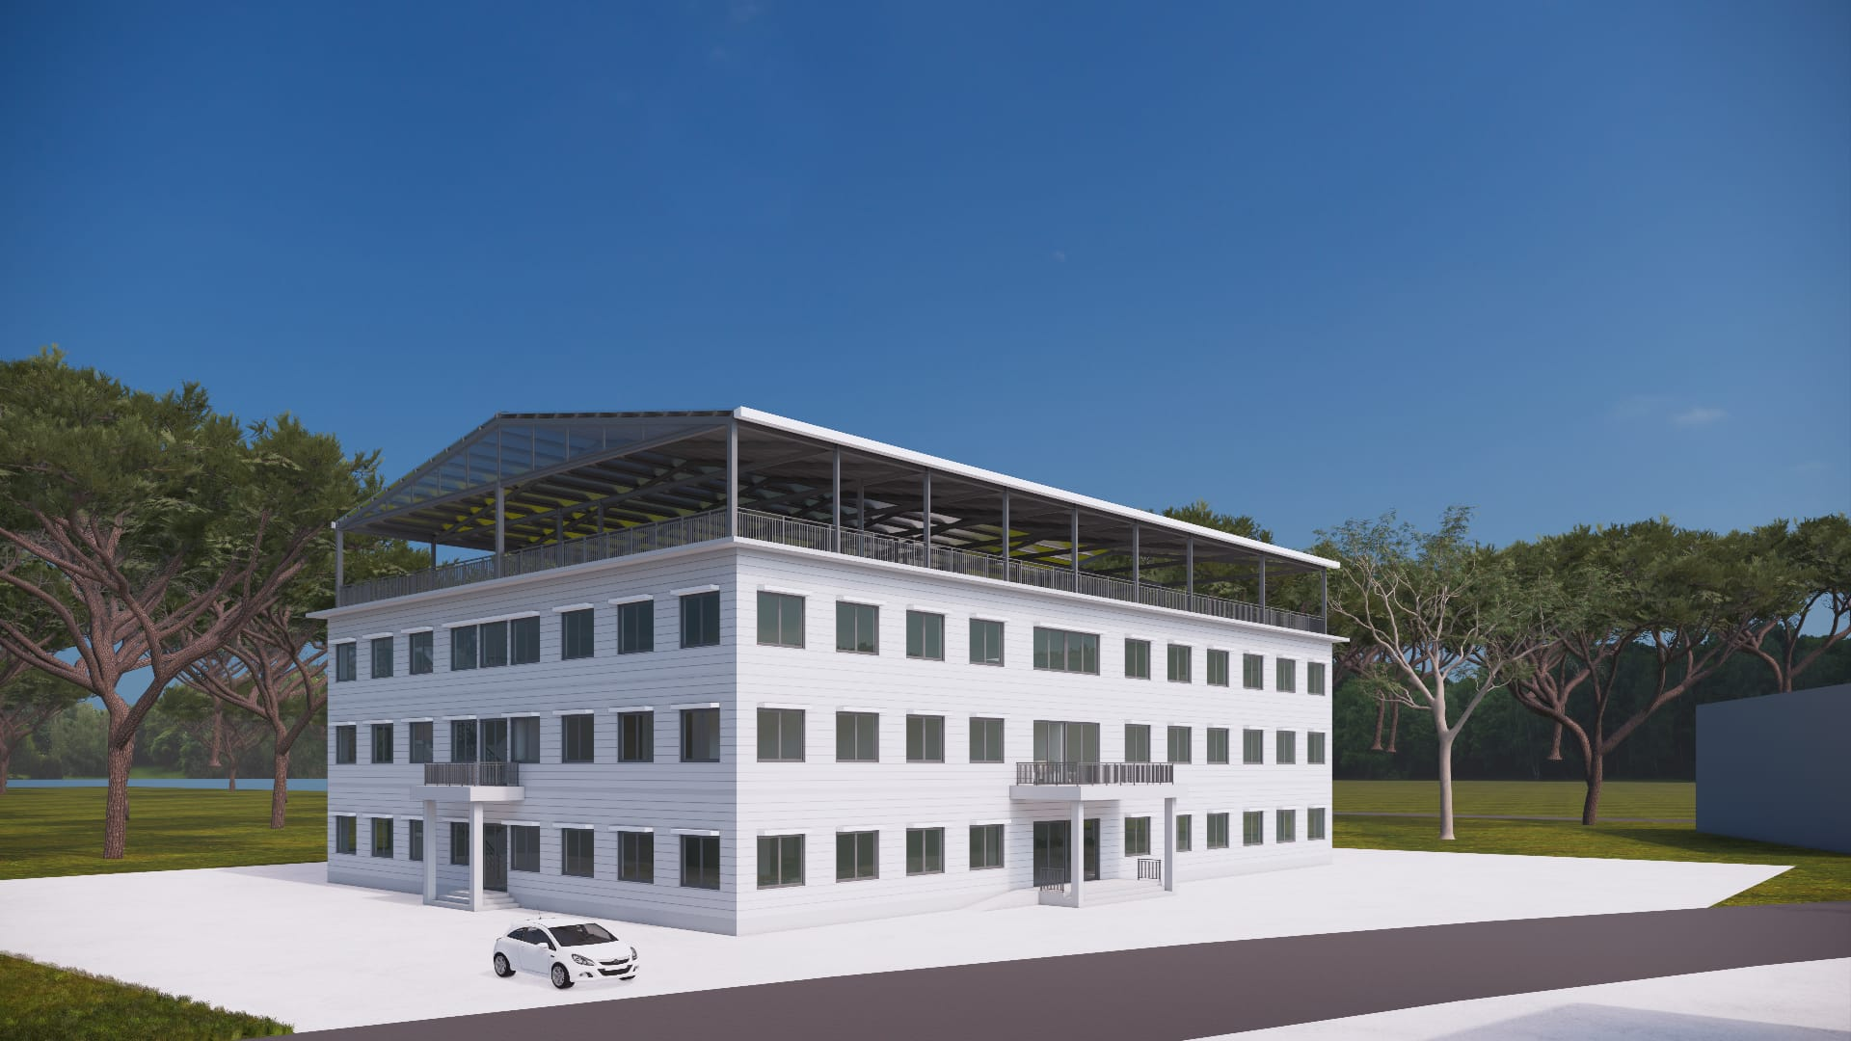

Slide 4
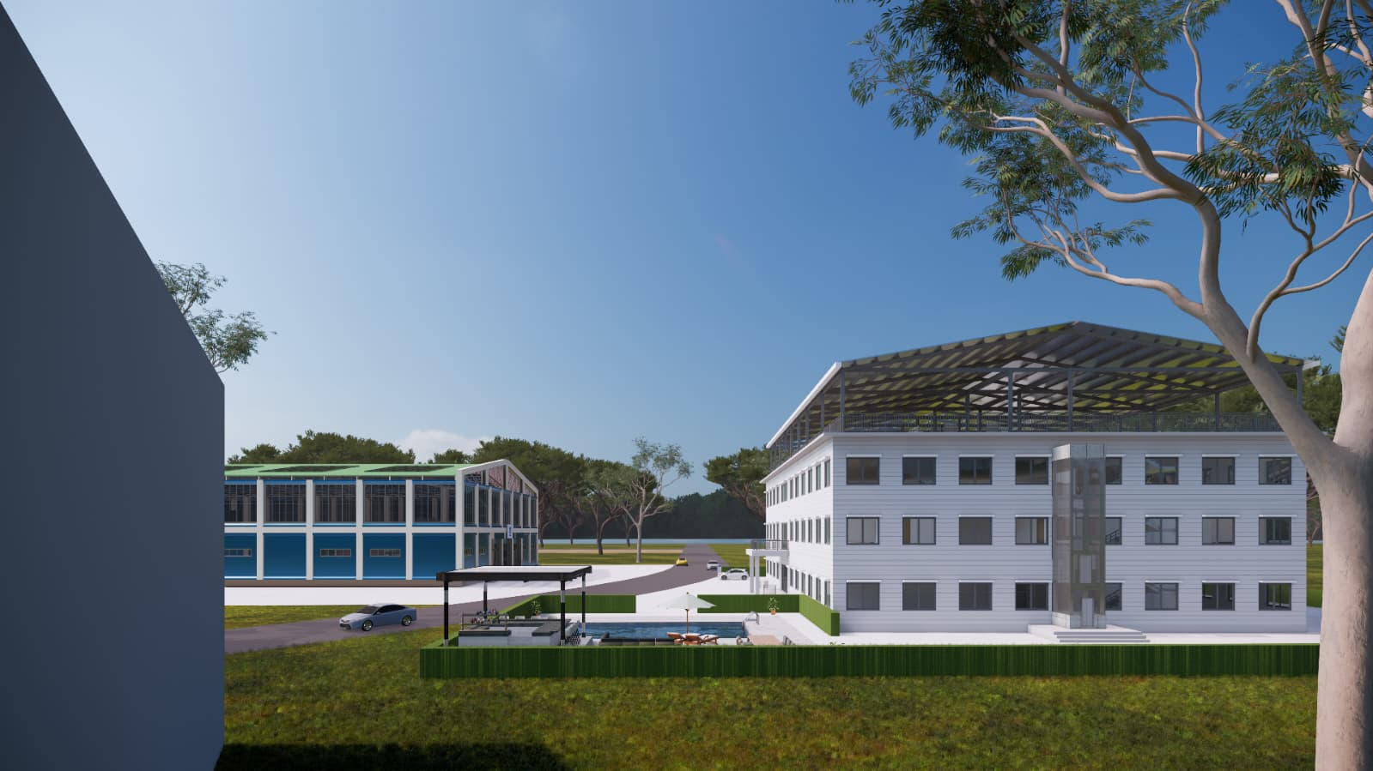

Slide 6
Building Size Breakdown
Guest rooms: 5,000–7,000 sq ft
Lobby: 1,500–3,000 sq ft
Gaming area: 1,000–2,000 sq ft
Total gross area: 12,000–20,000 sq ft

Slide 7
Construction Approach
Prefabricated steel structure from China
Multi-story design with reinforced framing
Optimized for rapid assembly

Slide 8
Material Costs (China)
Basic steel structure
Full prefab packages
Prices depend on finish level and engineering requirements

Slide 9
Import Duties & Taxes
Estimated: 5%–20%
Depends on classification and local regulations in Aruba

Slide 10
Turnkey Cost Estimates
Shell + installation
Fully finished

Slide 11
Key Cost Factors
Hurricane-resistant design requirements
Interior finish quality
Rooftop features
Local labor and foundation costs

Slide 12
Conclusion
Chinese prefab reduces material cost
Major costs still in installation and finishing
Proper planning required for logistics and compliance

